Slide 1
AINSPIRA Ai Agent Pengawasan Pemerintah Daerah
-Noam Chomsky-
23 December 2024

Slide 2



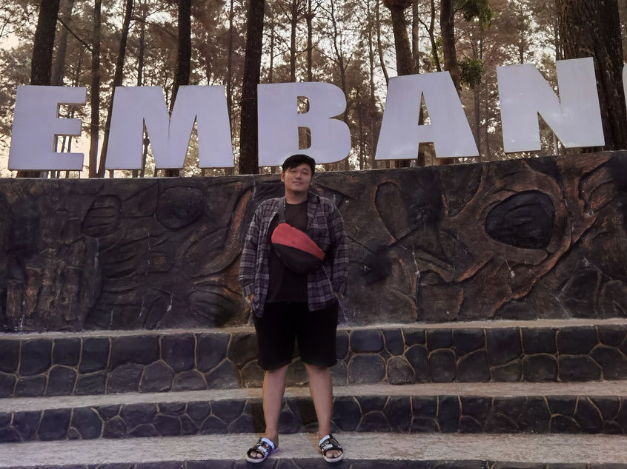

Meet The Team
Fadhillah Rojabhy
Yuan Shafira
Data Preparation & Analysis
Data Preparation & Analysis
fadhillahrojabhy
yuanshafira
Abdur Rozaq
Developer
abdur-rozaq

Slide 3


Outline
Background & Problem Statement
Objective & Scope
Data Information
EDA - Preprocessing
Workflow
Model Development
Results
Inference
Deployment/ Realworld App
Conclusion & Future Improvement

Slide 4

Background & Problem Statement
Governments often face challenges in managing and accessing data related to the supervision of programs, policies, and budgets quickly and accurately. This is due to data complexity, limited resources, and a lack of system integration, which can hinder the tasks of Government Internal Supervisory Apparatus (APIP) and other stakeholders.
The process of managing and accessing information and documents is gradual.
Supervision data is scattered across multiple tables.
Slow in retrieving data to support decision-making.
The large volume of files and data requires a more automated and easily accessible system.

Slide 5
Objective & Scope
Objective
Efficiency: Accelerate the search and provision of supervision information.
Accurate Decisions: Provide alternative data-driven decision-making recommendations.
Transparency: Facilitate access to information for stakeholders.
Automation: Reduce the manual workload of APIP.
Scope
Users: APIP & stakeholders
Capabilities:
Understand and respond to questions using NLP (Indonesian language).
Access regulations and supervision reports.
Limitations:
Supports as an alternative recommendation, not a replacement.
Relies on the quality of data within the system.
Integration:
Connected to the government supervision management information system (SiMAWAS).
Accessible via Website or WhatsApp.

Slide 6
Data Information
Dataset
Inspektorat/SiMAWAS
Data Fields
sentences (str) | User prompts
text_classification (str) | Text classification of user prompts (Laporan,File,Teks)
ner_tokens (conll) | Token for Named Entity Recognition (NER)
Text Classification | Num_rows
SiMAWAS | 915
NER | Num_rows
SiMAWAS | 450

Slide 7
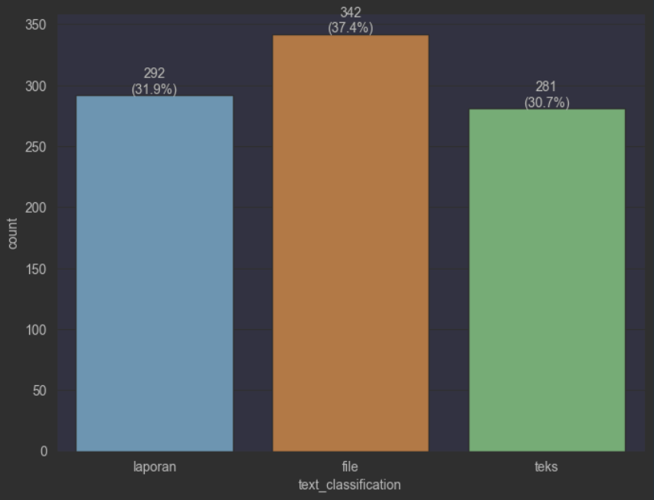
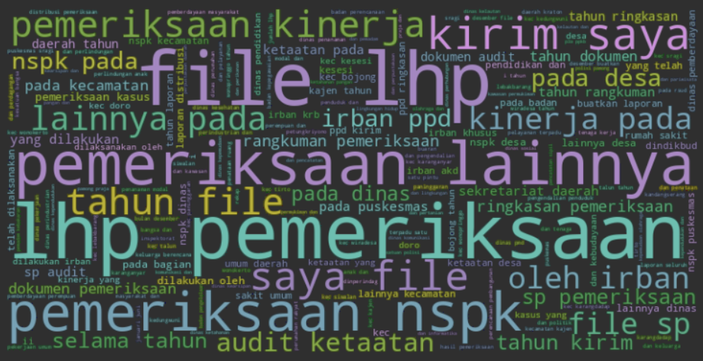
EDA & Preprocessing
Named Entity Recognition
B-PEM
I-PEM
B-IRBAN
I-IRBAN
B-AUDITI
I-AUDITI
B-DAT
I-DAT
B-LAP
I-LAP
O
Text Classification
Preprocessing
Preprocessing
Tokenization
Lowercase
Remove special characters
Label Encoding
The data is relatively balanced.
Text Classification `file` is the most frequent, with 342 instances (37.4%)
Text Classification `teks` is the least frequent, with 281 instances (30.7%).

Slide 8
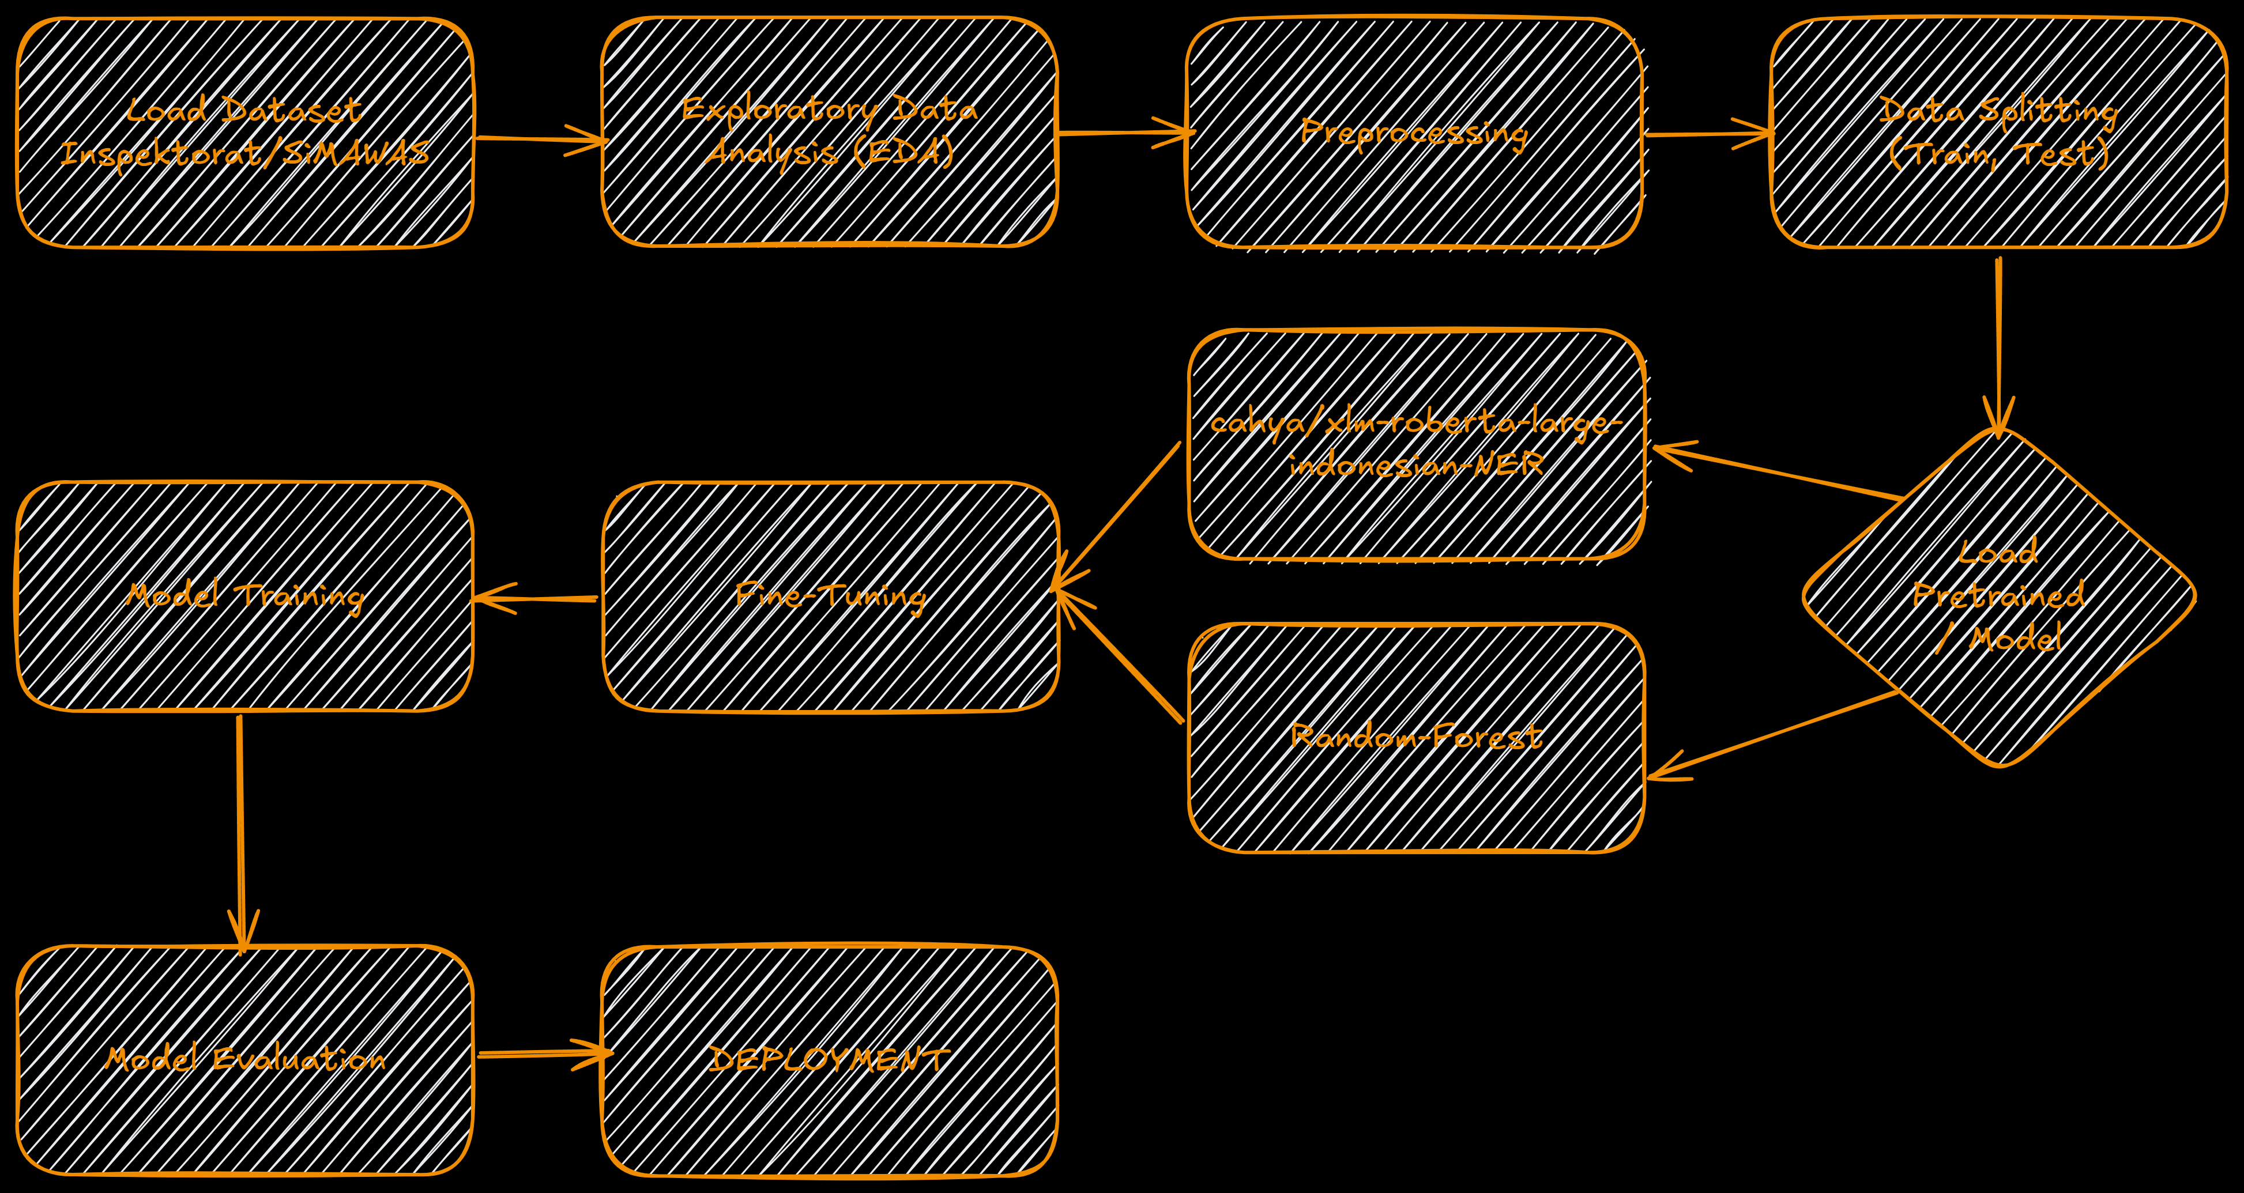
Workflow - Model

Slide 9
Model Development
TRAIN (80%)
TEST (20%)
Named Entity Recognition (NER)
model
cahya/xlm-roberta-large-indonesian-NER
Metrics Evaluation (NER)
Training Time
Train Loss, Val Loss
Accuracy
F1-Score, Recall, Precision
Text Classification
model
Random-Forest
Metrics Evaluation (Text Classification)
Accuracy (Test,Train)

Slide 10
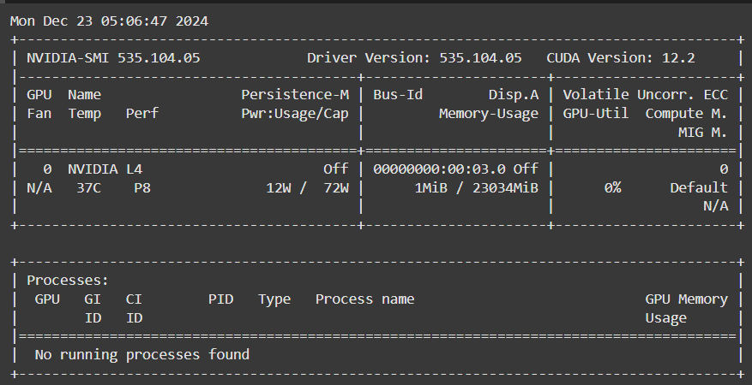
Result
Named Entity Recognition (NER)
ner | train time | train los | val_loss | accuracy | f1-score | recall | precision
cahya/xlm-roberta-large-indonesian-NER | 06:01 | 0.0989 | 0.1691 | 97,65% | 93,99% | 95,42% | 92,59%
Text Classification
teks-classification | train accuracy | test accuracy
Random-Forest | 84,38% | 75,01%

Slide 11
Inference
Named Entity Recognition (NER)
sentence | Predict | reference
buatkan laporan pemeriksaan *** selama tahun 2024 | PEM = pemeriksaan *** DAT = 2024 | PEM = pemeriksaan *** DAT = 2024
kirim saya file lhp pemeriksaan *** pada dinas ****** | LAP = lhp, PEM = pemeriksaan *** AUDITI = dinas *** | LAP = lhp, PEM = pemeriksaan *** AUDITI = dinas ***
buat laporan audit *** yang telah dilaksanakan oleh irban *** pada tahun 2022 - 2024 | PEM = audit *** IRBAN = irban *** DAT = 2022 DAT = 2024 | PEM = audit *** IRBAN = irban *** DAT = 2022 DAT = 2024
Laporan seluruh pemeriksaan dari tanggal 1 januari 2024 - 30 juni 2024 | PEM = pemeriksaan DAT = 1 januari 2024 DAT = 30 juni 2024 | PEM = pemeriksaan DAT = 1 januari 2024 DAT = 30 juni 2024
Dokumen lhp pemeriksaan *** pada dinas *** tahun 2022 | LAP = lhp PEM = pemeriksaan *** AUDITI = dinas *** DAT = 2022 | LAP = lhp PEM = pemeriksaan *** AUDITI = dinas *** DAT = 2022

Slide 12
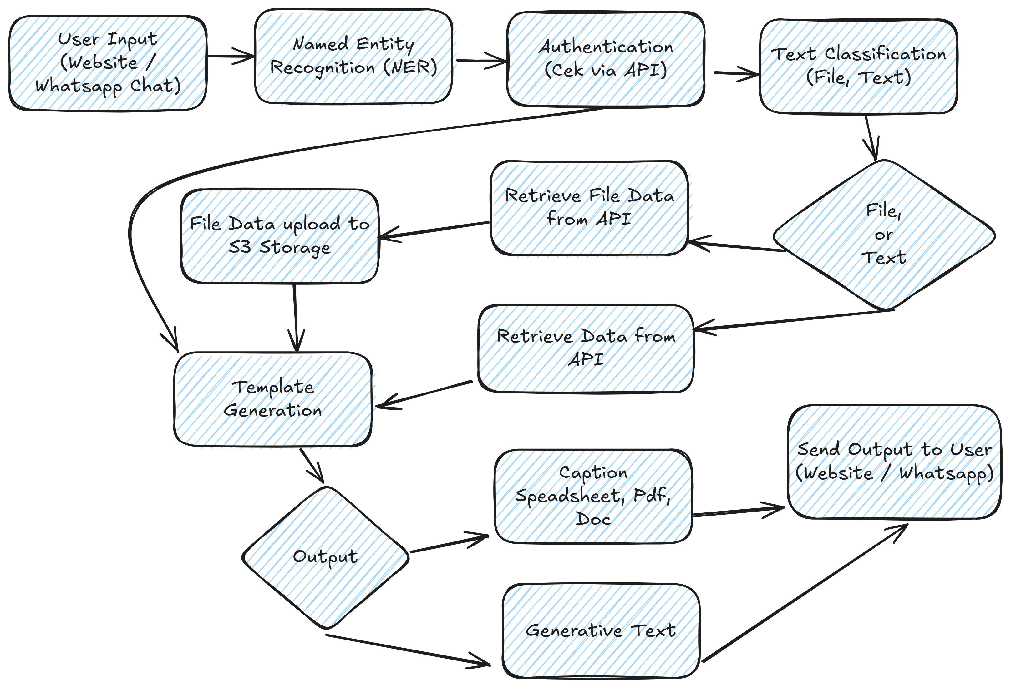







Real-World App
AInspira
AI Agent yang dirancang untuk mendukung pengawasan pemerintah daerah berbasis AI dengan kemampuan menjawab pertanyaan dengan output teks atau file. Dapat diakses melalui Website dan chat WhatsApp, Solusi ini bertujuan agar dalam mengelola dan mengakses data terkait pengawasan program, kebijakan, maupun anggaran dapat secara cepat, akurat dan terintegrasi.
TechStack

Slide 13
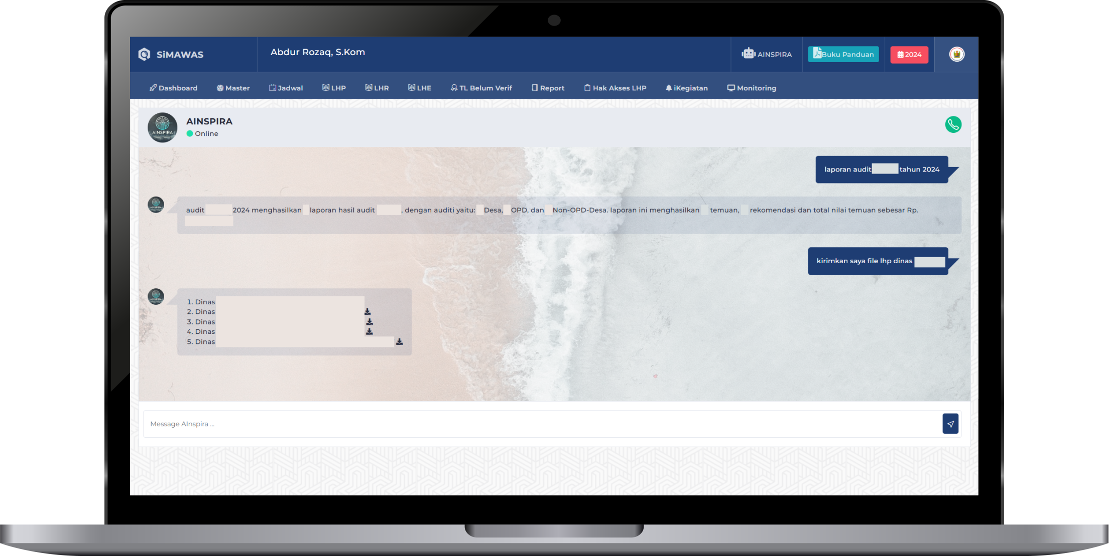
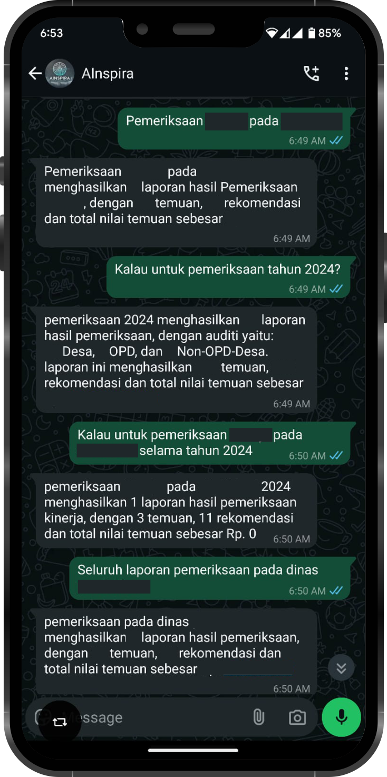
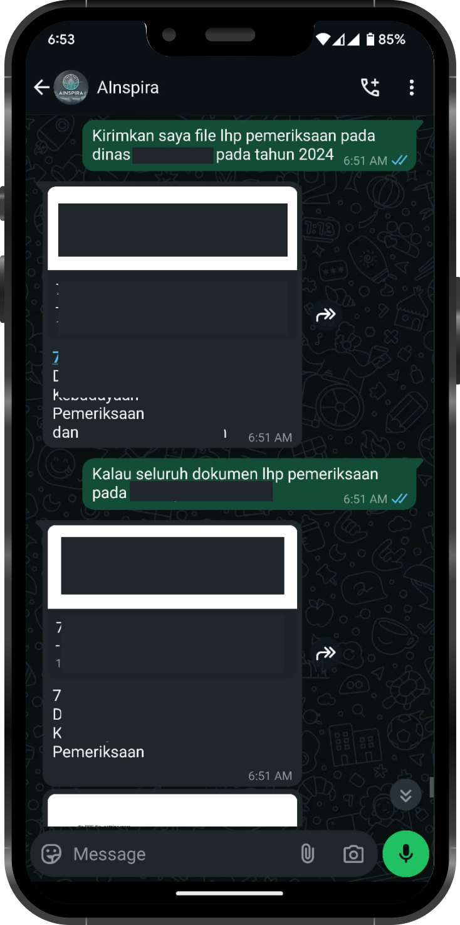
Real-World App
Website
WhatsApp

Slide 14
Conclusion & Future Improvement
Conclusion
AINSPIRA is an AI Agent designed to support Government supervision. With the capability to answer questions and provide outputs in text or file format, AINSPIRA can be accessed via a website and WhatsApp, offering flexibility to users. However, at present, the AI can only respond to user queries and directly invoke database functions upon request.
Future Improvement
Security: Conducting a comprehensive reevaluation of security measures.
Enhanced Interaction: Adding more complex interaction capabilities, such as interactive conversations
RAG Integration: Implementing Retrieval-Augmented Generation (RAG) to improve answer accuracy by integrating a knowledge base.
Context Management: Integrating the ability to manage context in conversations to ensure more relevant and in-depth responses.
Optimized Function Calling: Developing caching mechanisms or query management to minimize database load and enhance performance.
Scalability: Expanding support not only for existing supervision data but also external data such as policies, regulations, and more.
Dataset Enhancement: Increasing the quantity and quality of datasets to improve AI capabilities, especially in answering specific questions.
Auto-Labeling: Utilizing automatic labeling techniques on the dataset creation process, if possible, to make model development more efficient.

Slide 15

Thank You, any question ?

